Slide 1



Username:
Password:
Login with
Log In

Slide 2
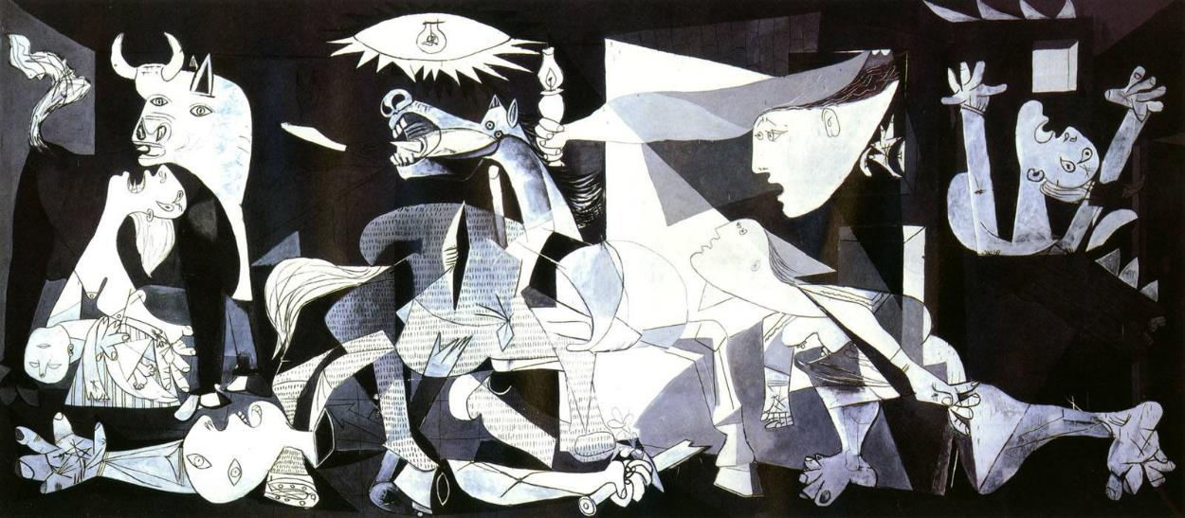
Guernica, 1937 by Pablo Picasso (Spanish, 1881-1973)

Slide 3
Guernica, 1937 by Pablo Picasso (Spanish, 1881-1973)
Select Viewlist
Select Player
Set Autoplay
Log Out

Slide 4




Select Viewlist
Picasso (212 images)
Old Masters (47 images)
Pop Art (32 images)
Impressionists (17 images)

Slide 5
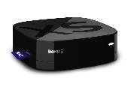

Select Player
MBR Roku
Sally’s Roku
Family Room TV

Slide 6

Set AutoPlay
Never
Every Morning
Every 1 Hour
Every 2 Hours
Every 3 Hours
Every 4 Hours
Set Interval to Automatically Change Image
Save

Slide 7
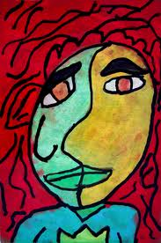
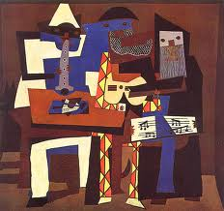
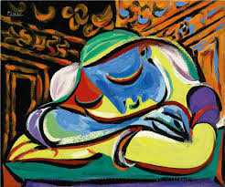
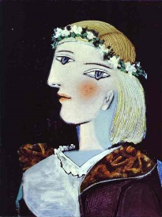
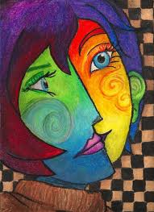
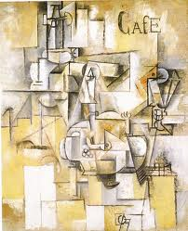
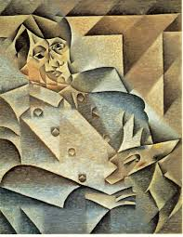
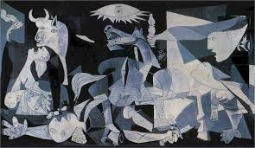
Pablo Picasso
Viewlists

